Slide 1
INTRODUCTION TO INDUSTRIAL CHEMISTRY
LECTURE-4
COURSE CODE: CHM-3112/512
COURSE TITLE: APPLIED CHEMISTRY-II
COURSE INCHARGE: DR. FARZANA NAZ

Slide 2
INTRODUCTION TO THE TOPIC
Industrial chemistry deals with commercial production of chemicals and related
products from natural raw materials and their derivatives. It enables humanity to
experience the benefits of chemistry when we apply it in the exploitation of materials and energy. When we apply chemistry in the transformation of materials and energy to make useable products, this results in growth and improvement in areas such as food production, health and hygiene, shelter and clothing. The economic growth of industrialized countries relies on the manufacturing industry for finished products. The goal of studying industrial chemistry at university is to try and bridge the gap between classical chemistry and chemistry is applied in industry.

Slide 3
CONTENTS OF THE LECTURE
Material Balances
The purpose of mass balance calculations
Batch process
Semi-Batch process
Continuous process
Steady state process
Un-steady state process
Material Balance calculation.

Slide 4
BUILDING ON (Prerequisites)
Process Control Systems in Industrial Processes
Benefits of an efficient process control system
In-Process methods
In-process quality control (IPQC)
Chemical Process Control in Finished Products

Slide 5
OBJECTIVES AND LEARNING GOALS
By the end of this lecture you should be familiar with:
What methods applied on the finished product in order to launch valueable quality product in the market.
What is meant by Material balance and what is its value in the manufacturing industry

Slide 6
Material Balances
Material balance involves calculations the quantities of all materials that enter and leave any system or process which are based on the principle of the "law of conversation of mass". This law states that “Matter is neither created nor destroyed in the process and the total mass remains unchanged.”
The purpose of mass balance calculations
Mass balance calculations serve the following purposes:
They help us know the amount and composition of each stream in the process.
We are able to make technical and economic evaluation of the process and
process units from the knowledge of material and energy consumption and product yield obtained.
We can quantitatively know the environmental emissions of the process.
In mass balance calculations, we begin with two assumptions
There is no transfer of mass to energy
Mass is conserved for each element or compound on either molar or weight basis

Slide 7
Mass balance equation takes care of all these aspects. The following is a general mass
balance equation.
Simply put:
Accumulation =Flow in – Flow out + Production – Consumption
The system is any process or portion of a process chosen for analysis.
A system is said to be “open” if material flows across the system boundary during the interval of time being studied;
“closed” if there are no flows in or out.
Accumulation is usually the rate of change of holdup of material within the system. If material is increasing, accumulation is positive; if it is decreasing, it is negative. If the system does not change with time, it is said to be at steady state, and the net accumulation will be zero.

Slide 8
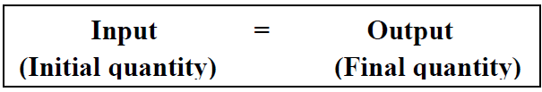
Batch process:
The feed materials are placed into the system (reactor, mixer, filter,….etc) at the beginning of the process. These materials are held for a period of time known as “Residence time" or " Retention period" during which the required physical and/or chemical changes are occurred. The products are removed all at once after this time. No masses crossed the system boundary during this time. Batch process fall into the category of closed systems.
The basis used in such processes is usually "one batch", and the material balance for physical batch processes in which there is no chemical reaction, It can be written as:
This equation can be applied for every substance (component balance) or for total materials (total material balance).

Slide 9
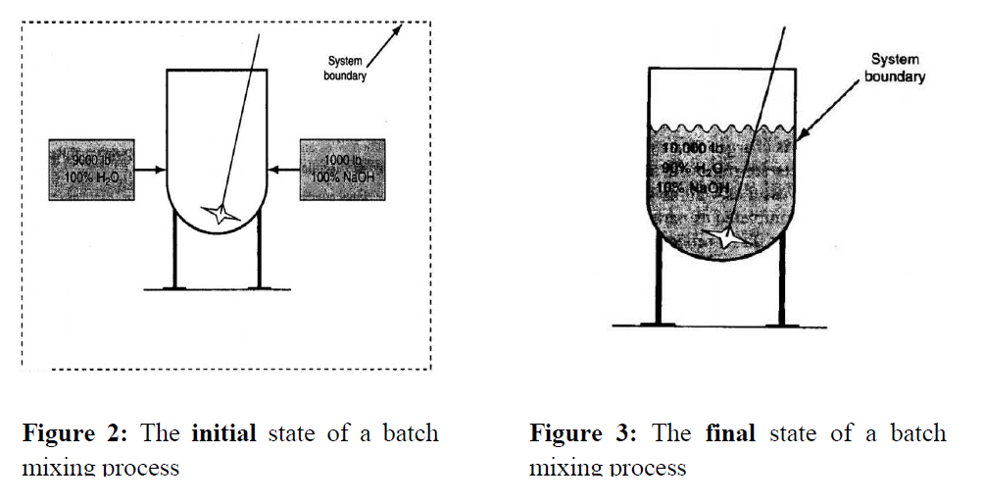

Slide 10
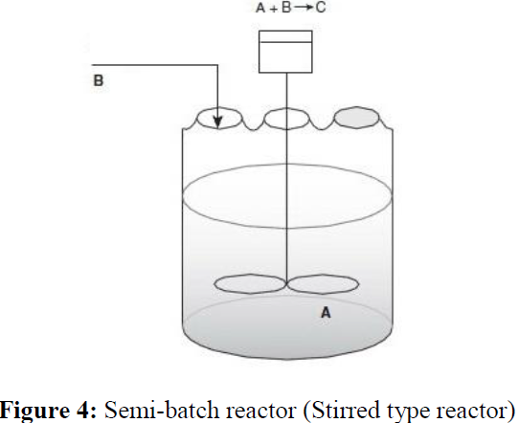
Semi-batch process:
A semi-batch reactor of stirred type tank as shown in the Figure 4, often used for its own particular characteristics. In this type, all quantity of one reactant is initially put in the reactor, and then other reactants are continuously fed. Only flows enter the systems, and no leave, hence the system is an unsteady state. This arrangement is useful when the heat of reaction is large. The heat evolved can be controlled by regulating the rate of addition of one of the reactants.

Slide 11
Continuous process (Flow process):
The input and output materials are continuously transferred across the system boundary; i.e. the feed continuously enters the system and the product continuously leaves the system. The physical and/or chemical changes take place during the flow of materials through the effective parts of equipments (packing, sieve plate, filter cloth,…etc). A convenient period of time such as minute, hour, or day must chosen as a basis over which material balance calculations be made.
This type of processes can be classified as "steady state" and "unsteady state" processes.
Steady state process:
The steady state process can be defined as that process in which all the operating conditions (temperature, pressures, compositions, flow rate,…..etc.) remains constant with time. In such process there is no accumulation in the system, and the equation of material balance can be written as:

Slide 12
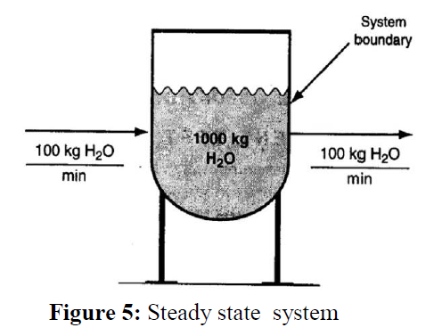

Unsteady state process:
For an unsteady state process, not all of the operating conditions in the process (e.g., temperature, pressure, compositions, flow rate,… etc.) remain constant with time, and/or the flows in and out of the system can vary with time, hence the accumulation of materials within can be written as follows:

Slide 13
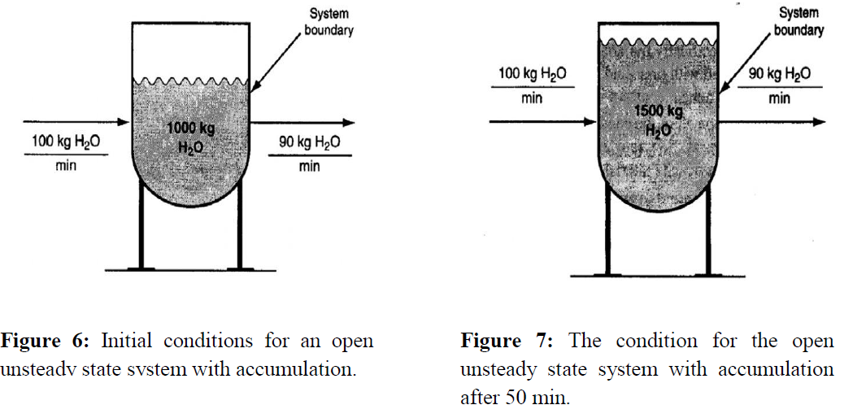
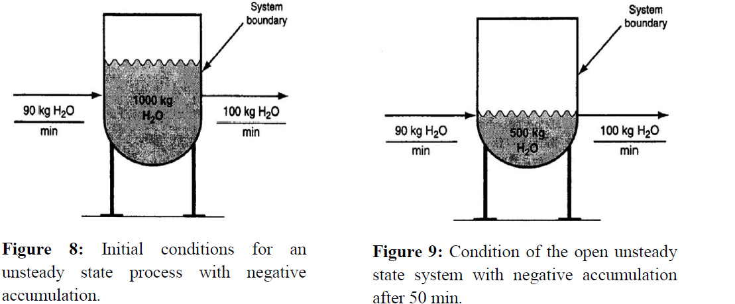

Slide 14
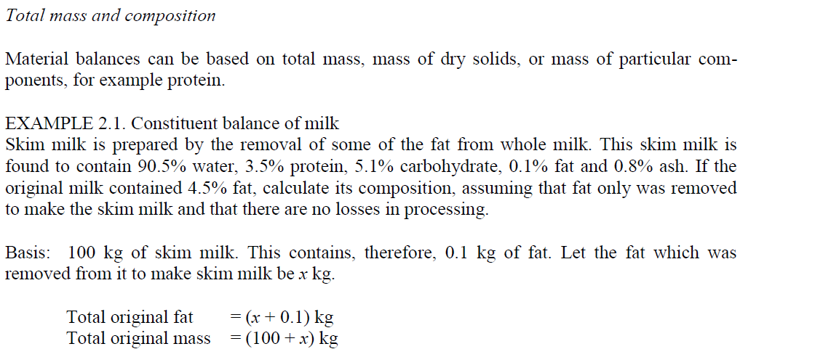

Slide 15
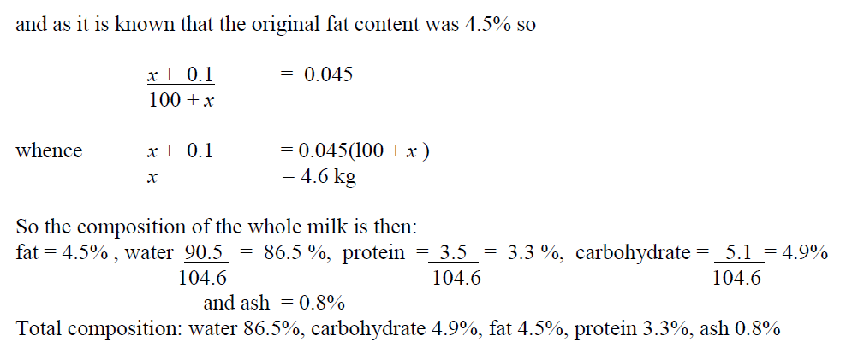

Slide 16
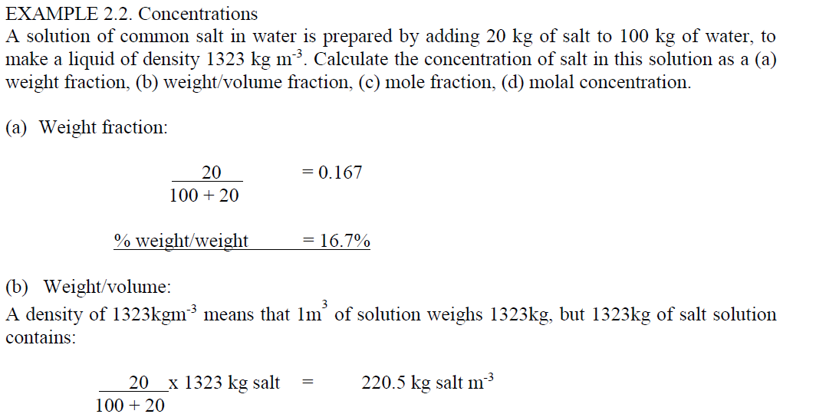

Slide 17
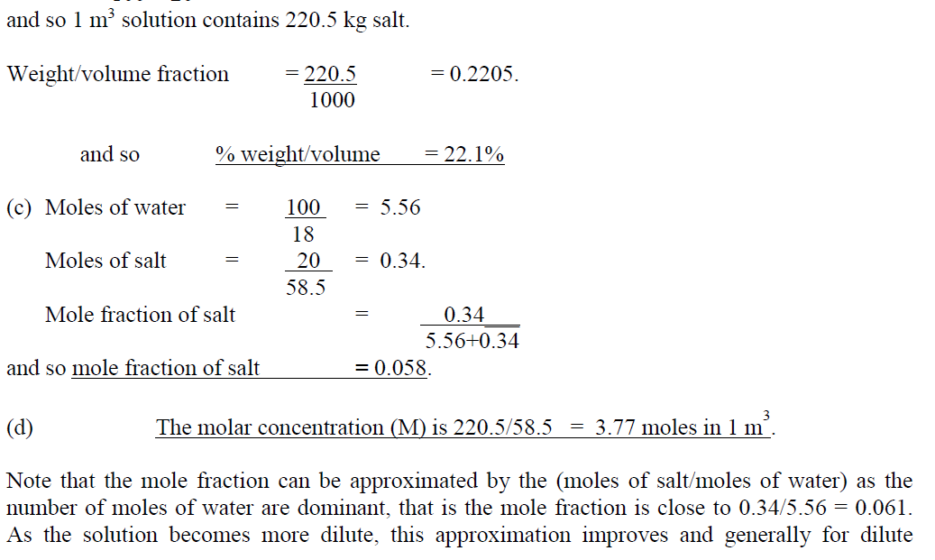
solutions the mole fraction of solute is a close approximation to the moles of solute/moles of solvent.

Slide 18
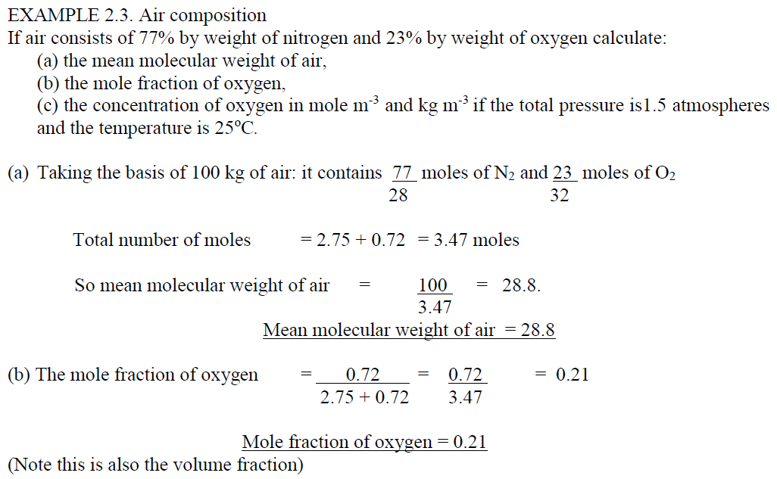

Slide 19
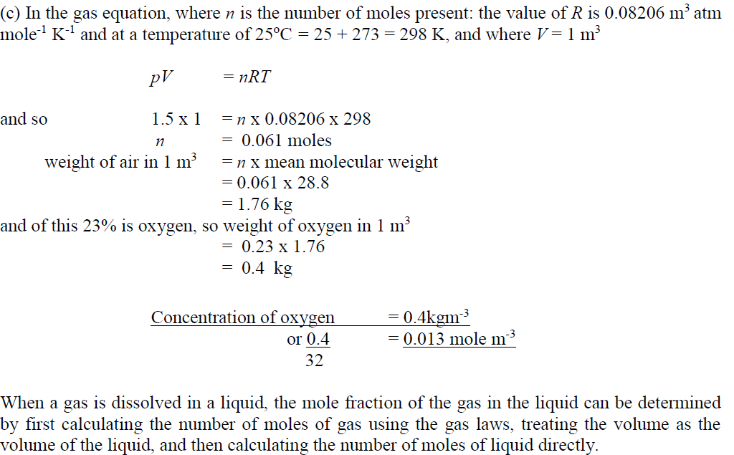

Slide 20
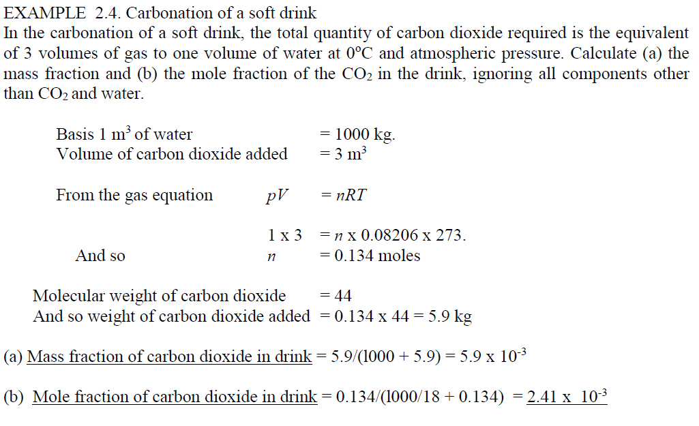

Slide 21
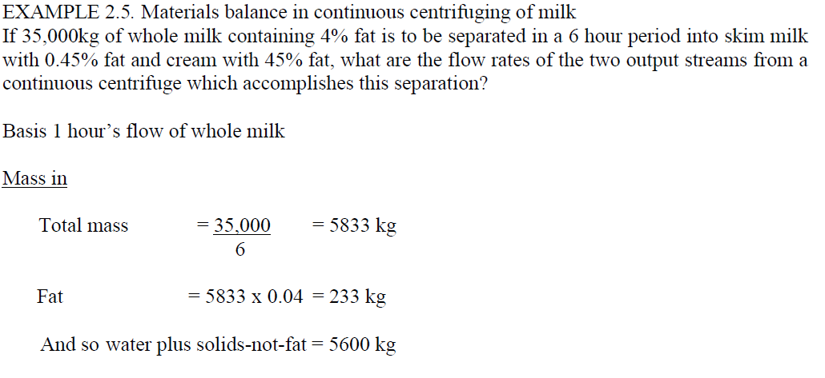

Slide 22
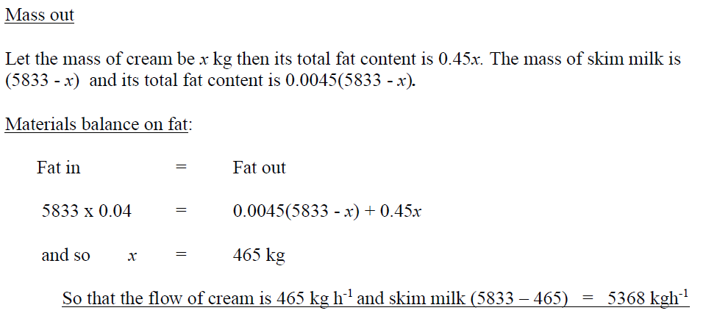
The time unit has to be considered carefully in continuous processes as normally such processes operate continuously for only part of the total factory time. Usually there are three periods, start up, continuous processing (so-called steady state) and close down, and it is important to decide
what material balance is being studied.

Slide 23
REFERENCES
Wanasolo William, Helen Njenga “Industrial Chemistry,” University of
Nairobi and William Wanasolo (2007).
Ahmed Daham “Basic Principles and Calculations in Chemical Engineering ,”
University of Tikrit, 1st Edition

Slide 24
INTERACTION WITH STUDENTS
NOTE: Ask question if u have any queries about today’s lecture on whatsapp and discussion forum on LMS to describe how your personal bias might affect your interpretation of material presented today.
An interactive session will also be conducted on zoom meeting regarding queries about this lecture.

Slide 25


